Slide 1
Communication
Chapter 3

Slide 2
Agenda
3.1 Layered protocols
3.2 Remote Procedure
3.3 Remote Object Invocation
3.4 Message-Oriented Communication
3.5 Stream-Oriented Communication

Slide 3
3.1 Layered Protocols

Slide 4
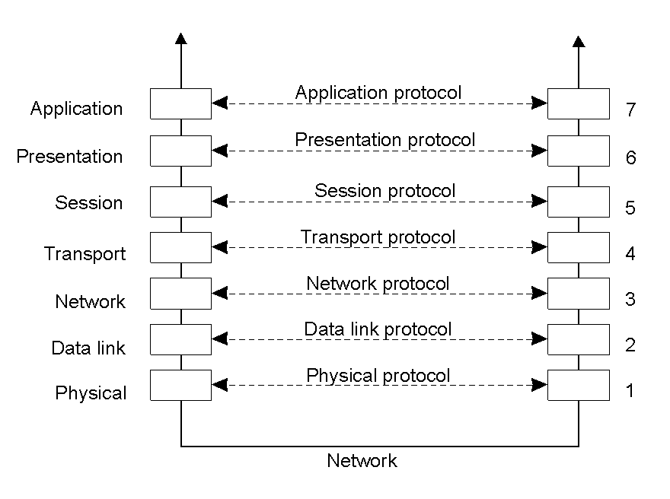
1 - Layered Protocols
OSI: Open Systems Interconnection
Developed by the International Organization for Standardization (ISO)
Provides a generic framework to discuss the layers and functionalities of communication protocols.
Layers, interfaces, and protocols in the OSI model.

Slide 5
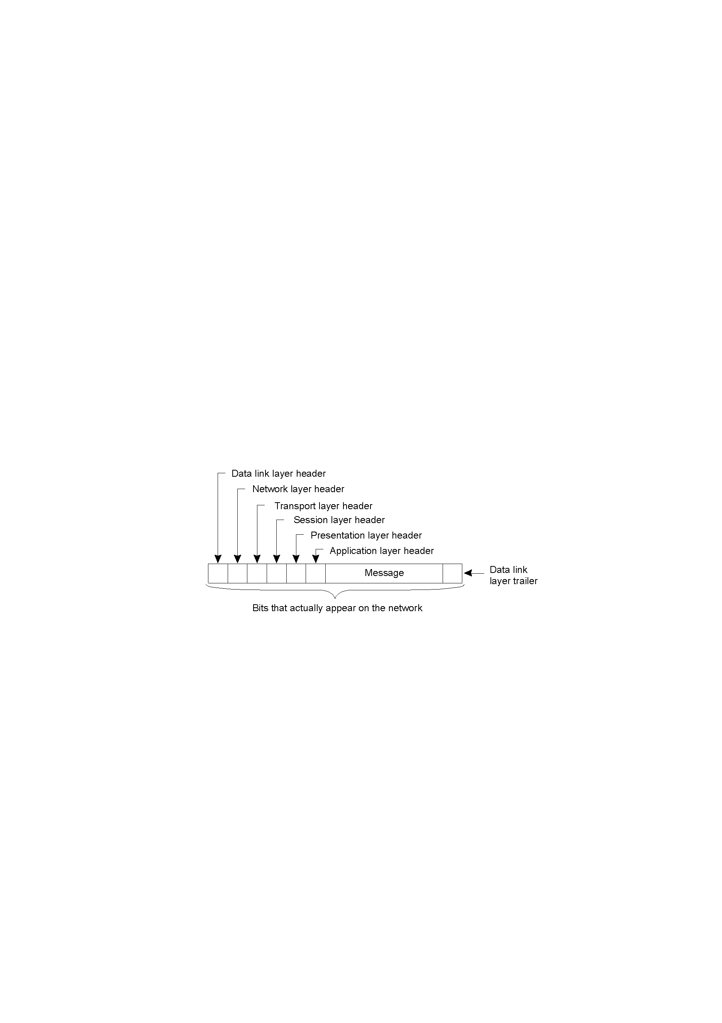
OSI Model (con.t)
A typical message as it appears on the network.

Slide 6
OSI Protocol Layers
Physical layer
  Deals with the transmission of bits
  Physical interface between data transmission device
  (e.g. computer) and transmission medium or network
  Concerned with:
    Characteristics of transmission medium, Signal levels, Data rates
Data link layer:
  Deals with detecting and correcting bit transmission errors
  Bits are group into frames
  Checksums are used for integrity

Slide 7
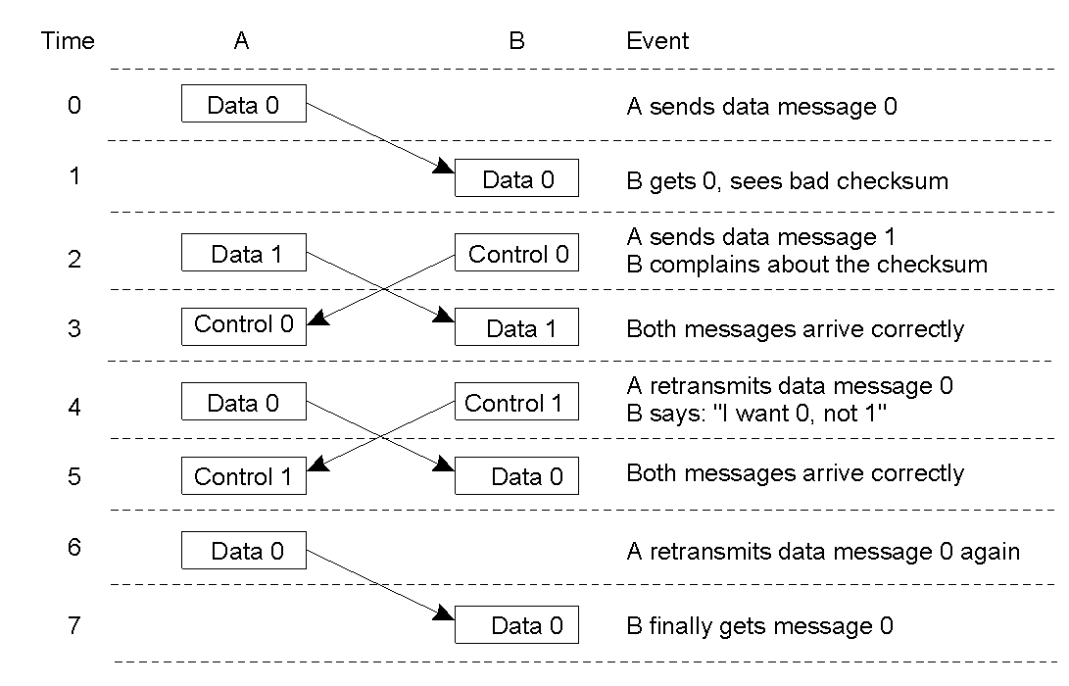
OSI Protocol Layers (con.t)
Discussion between a receiver and a sender in the data link layer.

Slide 8
OSI Protocol Layers (con.t)
Network layer:
  Performs multi-hop routing across multiple networks
  Implemented in end systems and routers
Transport layer:
  Packing of data
  Reliable delivery of data (breaks message into pieces small enough, assign each one a sequence number and then send them)
  Ordering of delivery
  Examples:
    TCP (connection-oriented)
    UDP (connectionless)
    RTP (Real-time Transport Protocol)

Slide 9
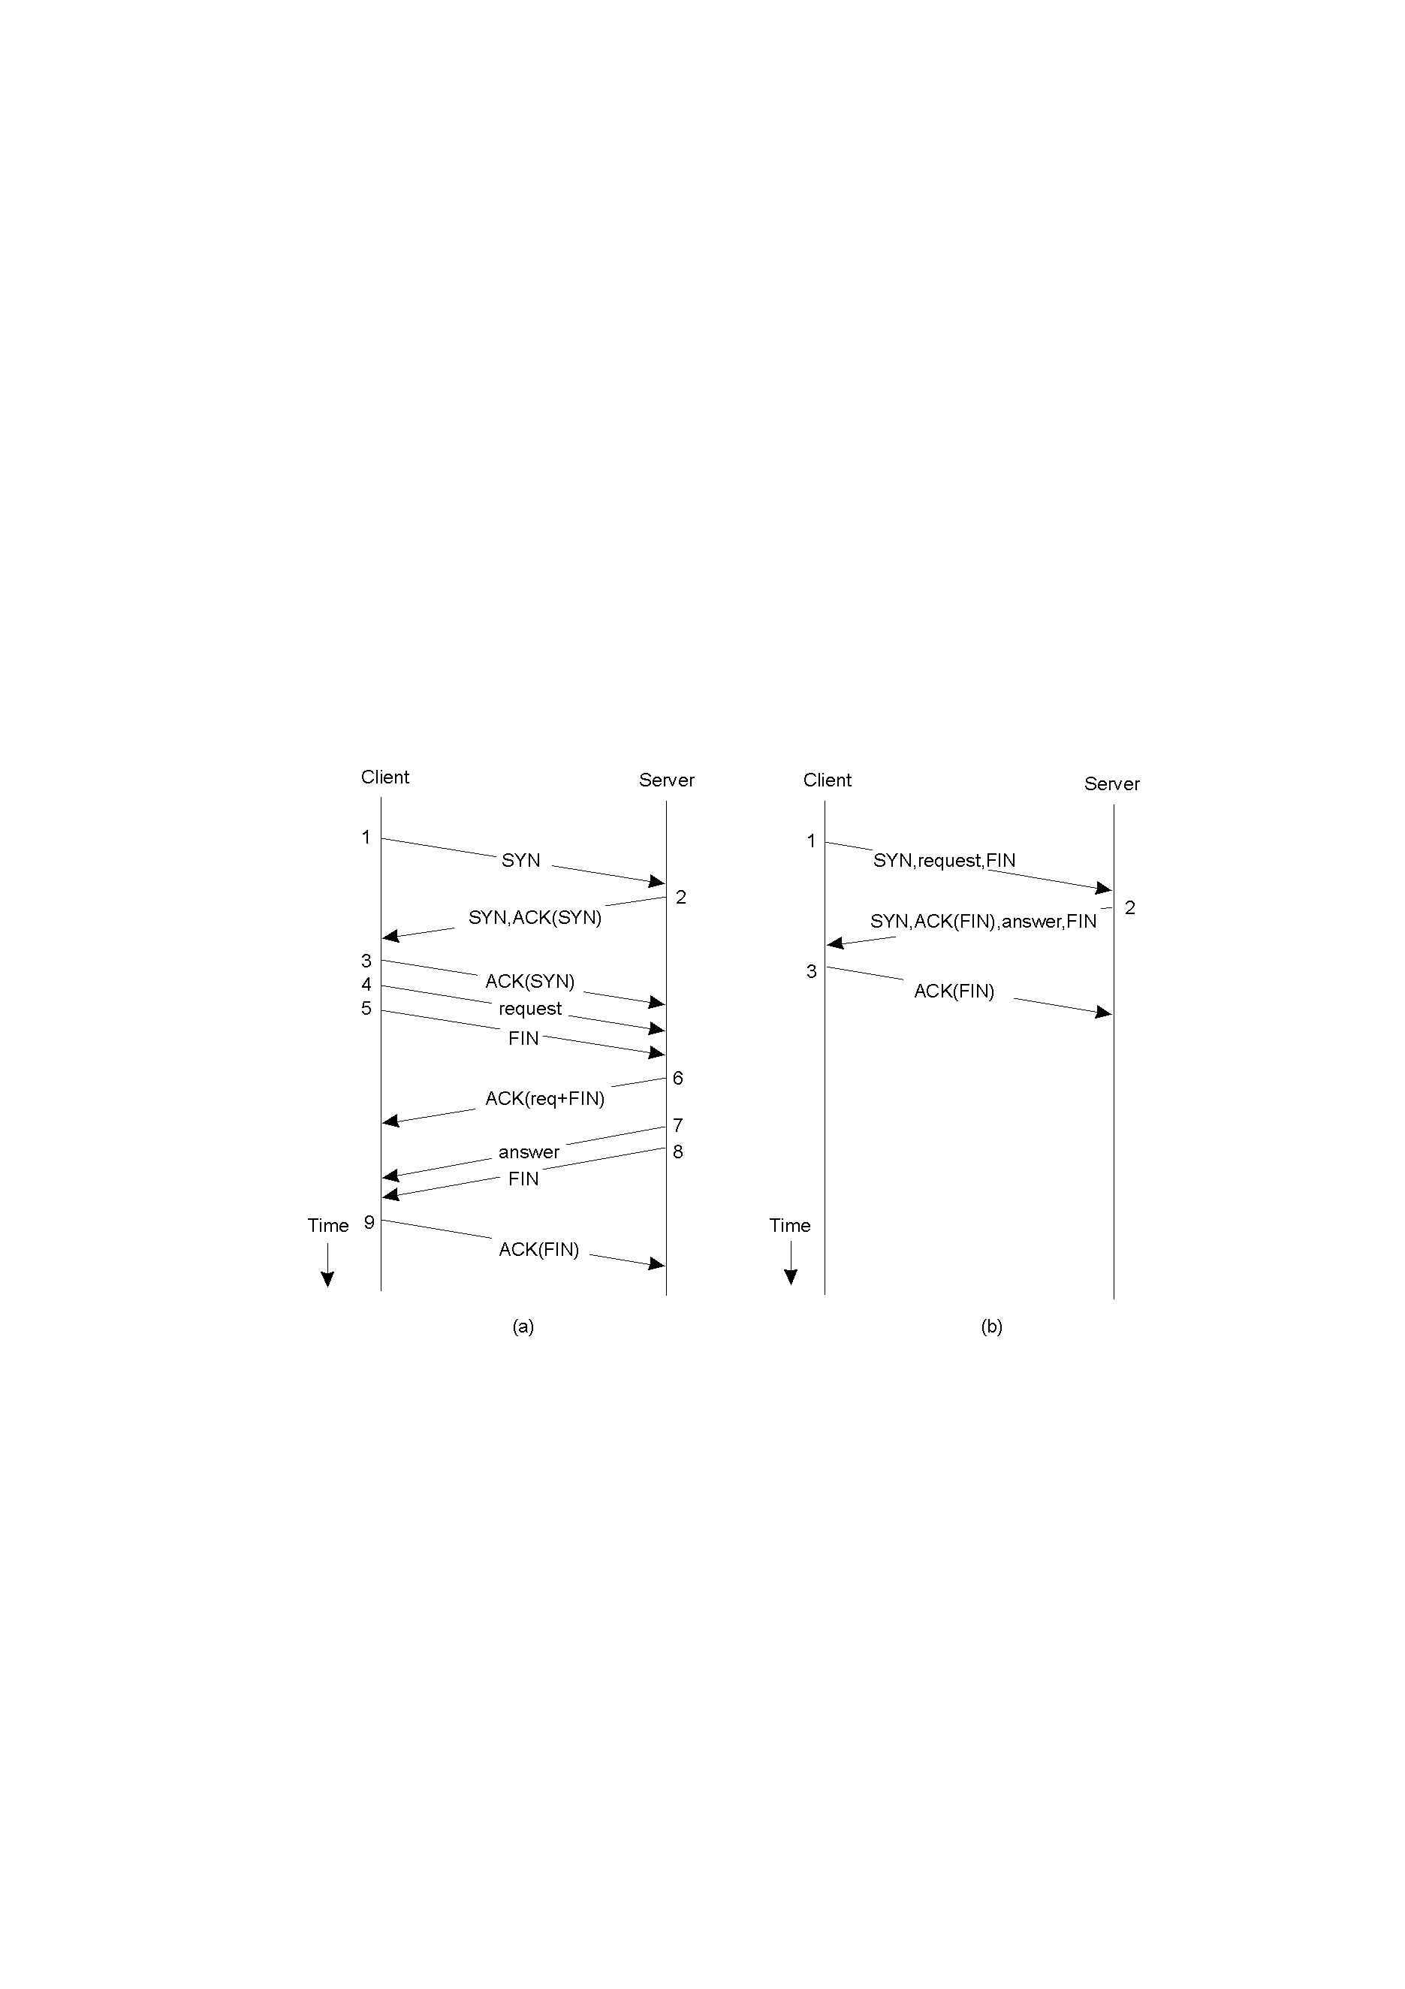
OSI Protocol Layers (con.t)
Client-Server TCP protocol
(a) Normal operation of TCP. (b) Transactional TCP.

Slide 10
OSI Protocol Layers (con.t)
Session layer
  Provide dialog control to keep track of which party is talking and it provides synchronization facilities
Presentation layer
  Deals with non-uniform data representation and with compression and encryption
Application layer
  Support for user applications
  e.g. HTTP, SMPT, FTP

Slide 11

Middleware Protocols
Support high-level communication services
The session and presentation layers are merged into the middleware layer,
Ex: Microsoft ODBC (Open Database Connectivity), OLE DB…
An adapted reference model for networked communication.

Slide 12
3.2 Remote Procedure Call

Slide 13
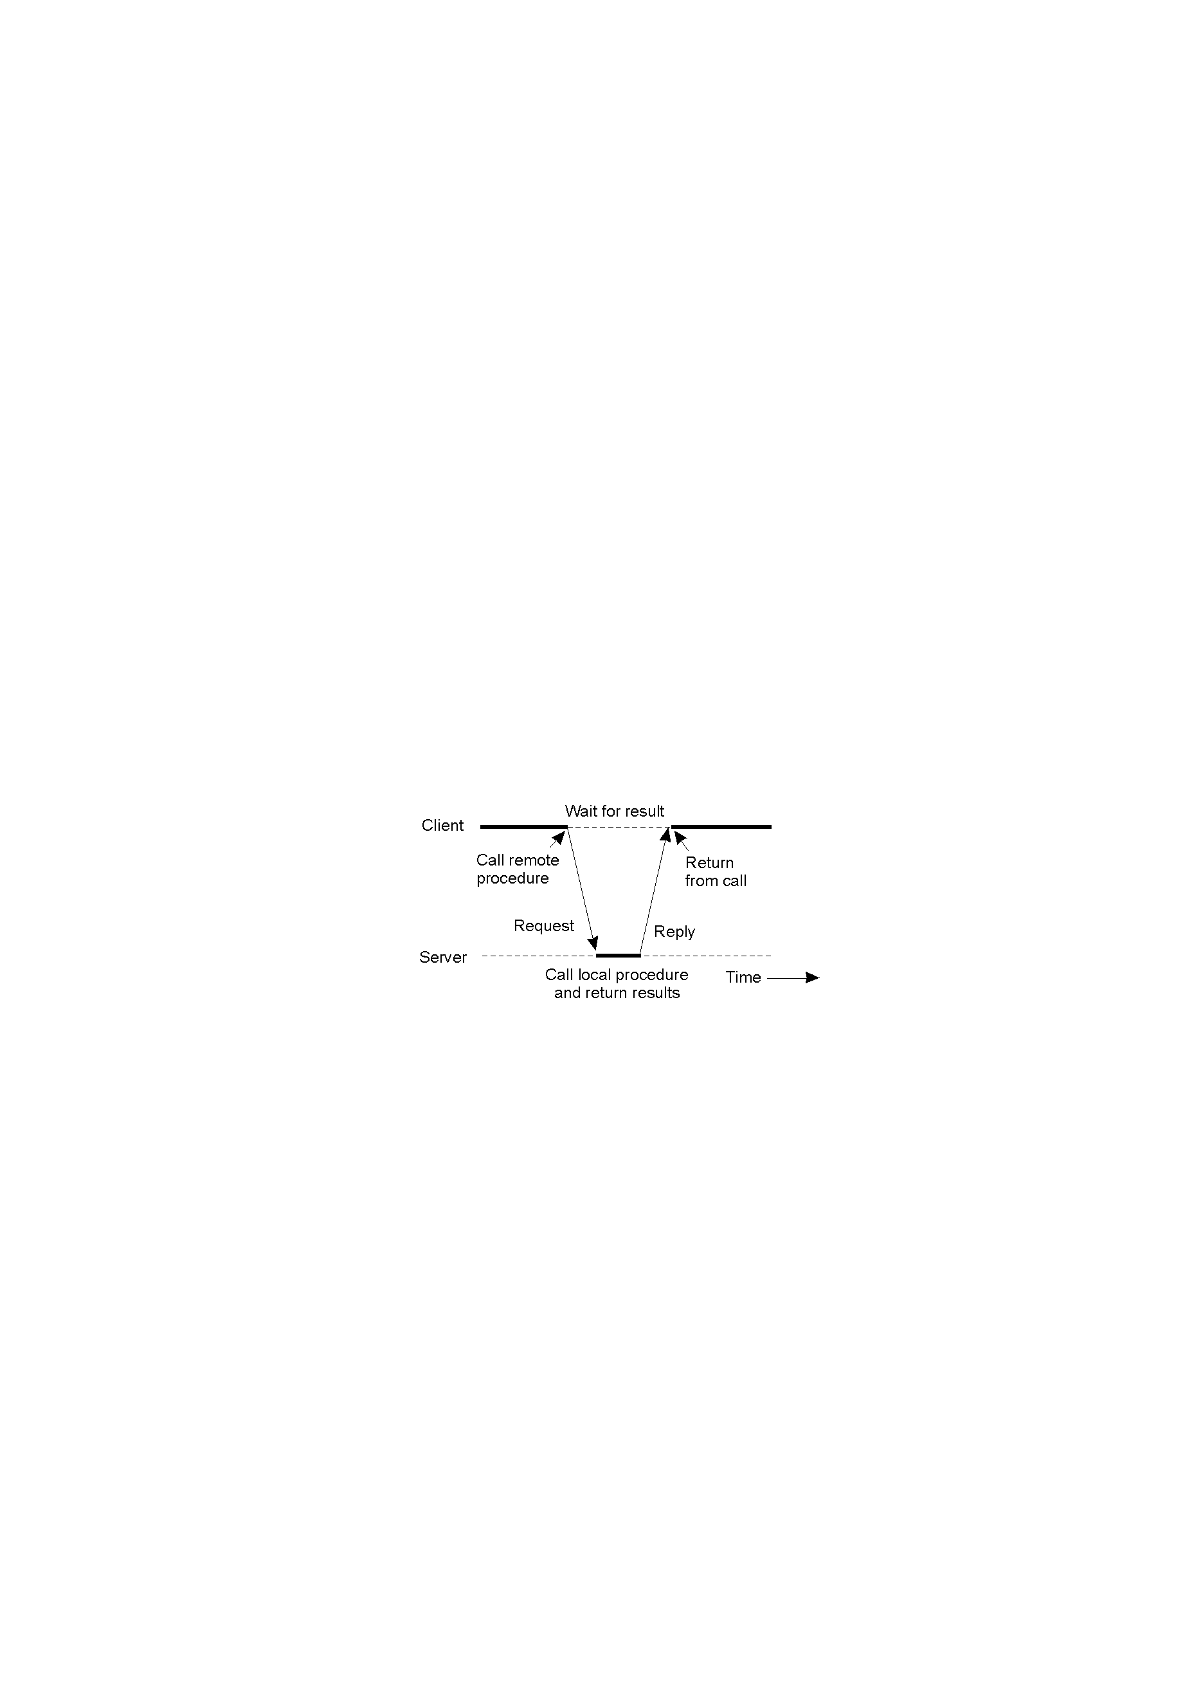
Remote Procedure call
Basic idea: To execute a procedure at a remote site and ship the results back.
Goal: To make this operation as distribution transparent as possible (i.e., the remote procedure call should look like a local one to the calling procedure).
Example:
read(fd, buf, nbytes)

Slide 14
Client and Server Stubs
Definition: Are additional functions which are added to the main functions in order to support for RPC
Client
Server
count = doSomething();
procedure doSomething();
Client Stub
Server Stub
OS
OS

Slide 15
Steps of a Remote Procedure Call
Client procedure calls client stub in normal way
Client stub builds message, calls local OS
Client's OS sends message to remote OS
Remote OS gives message to server stub
Server stub unpacks parameters, calls server
Server does work, returns result to the stub
Server stub packs it in message, calls local OS
Server's OS sends message to client's OS
Client's OS gives message to client stub
Stub unpacks result, returns to client

Slide 16
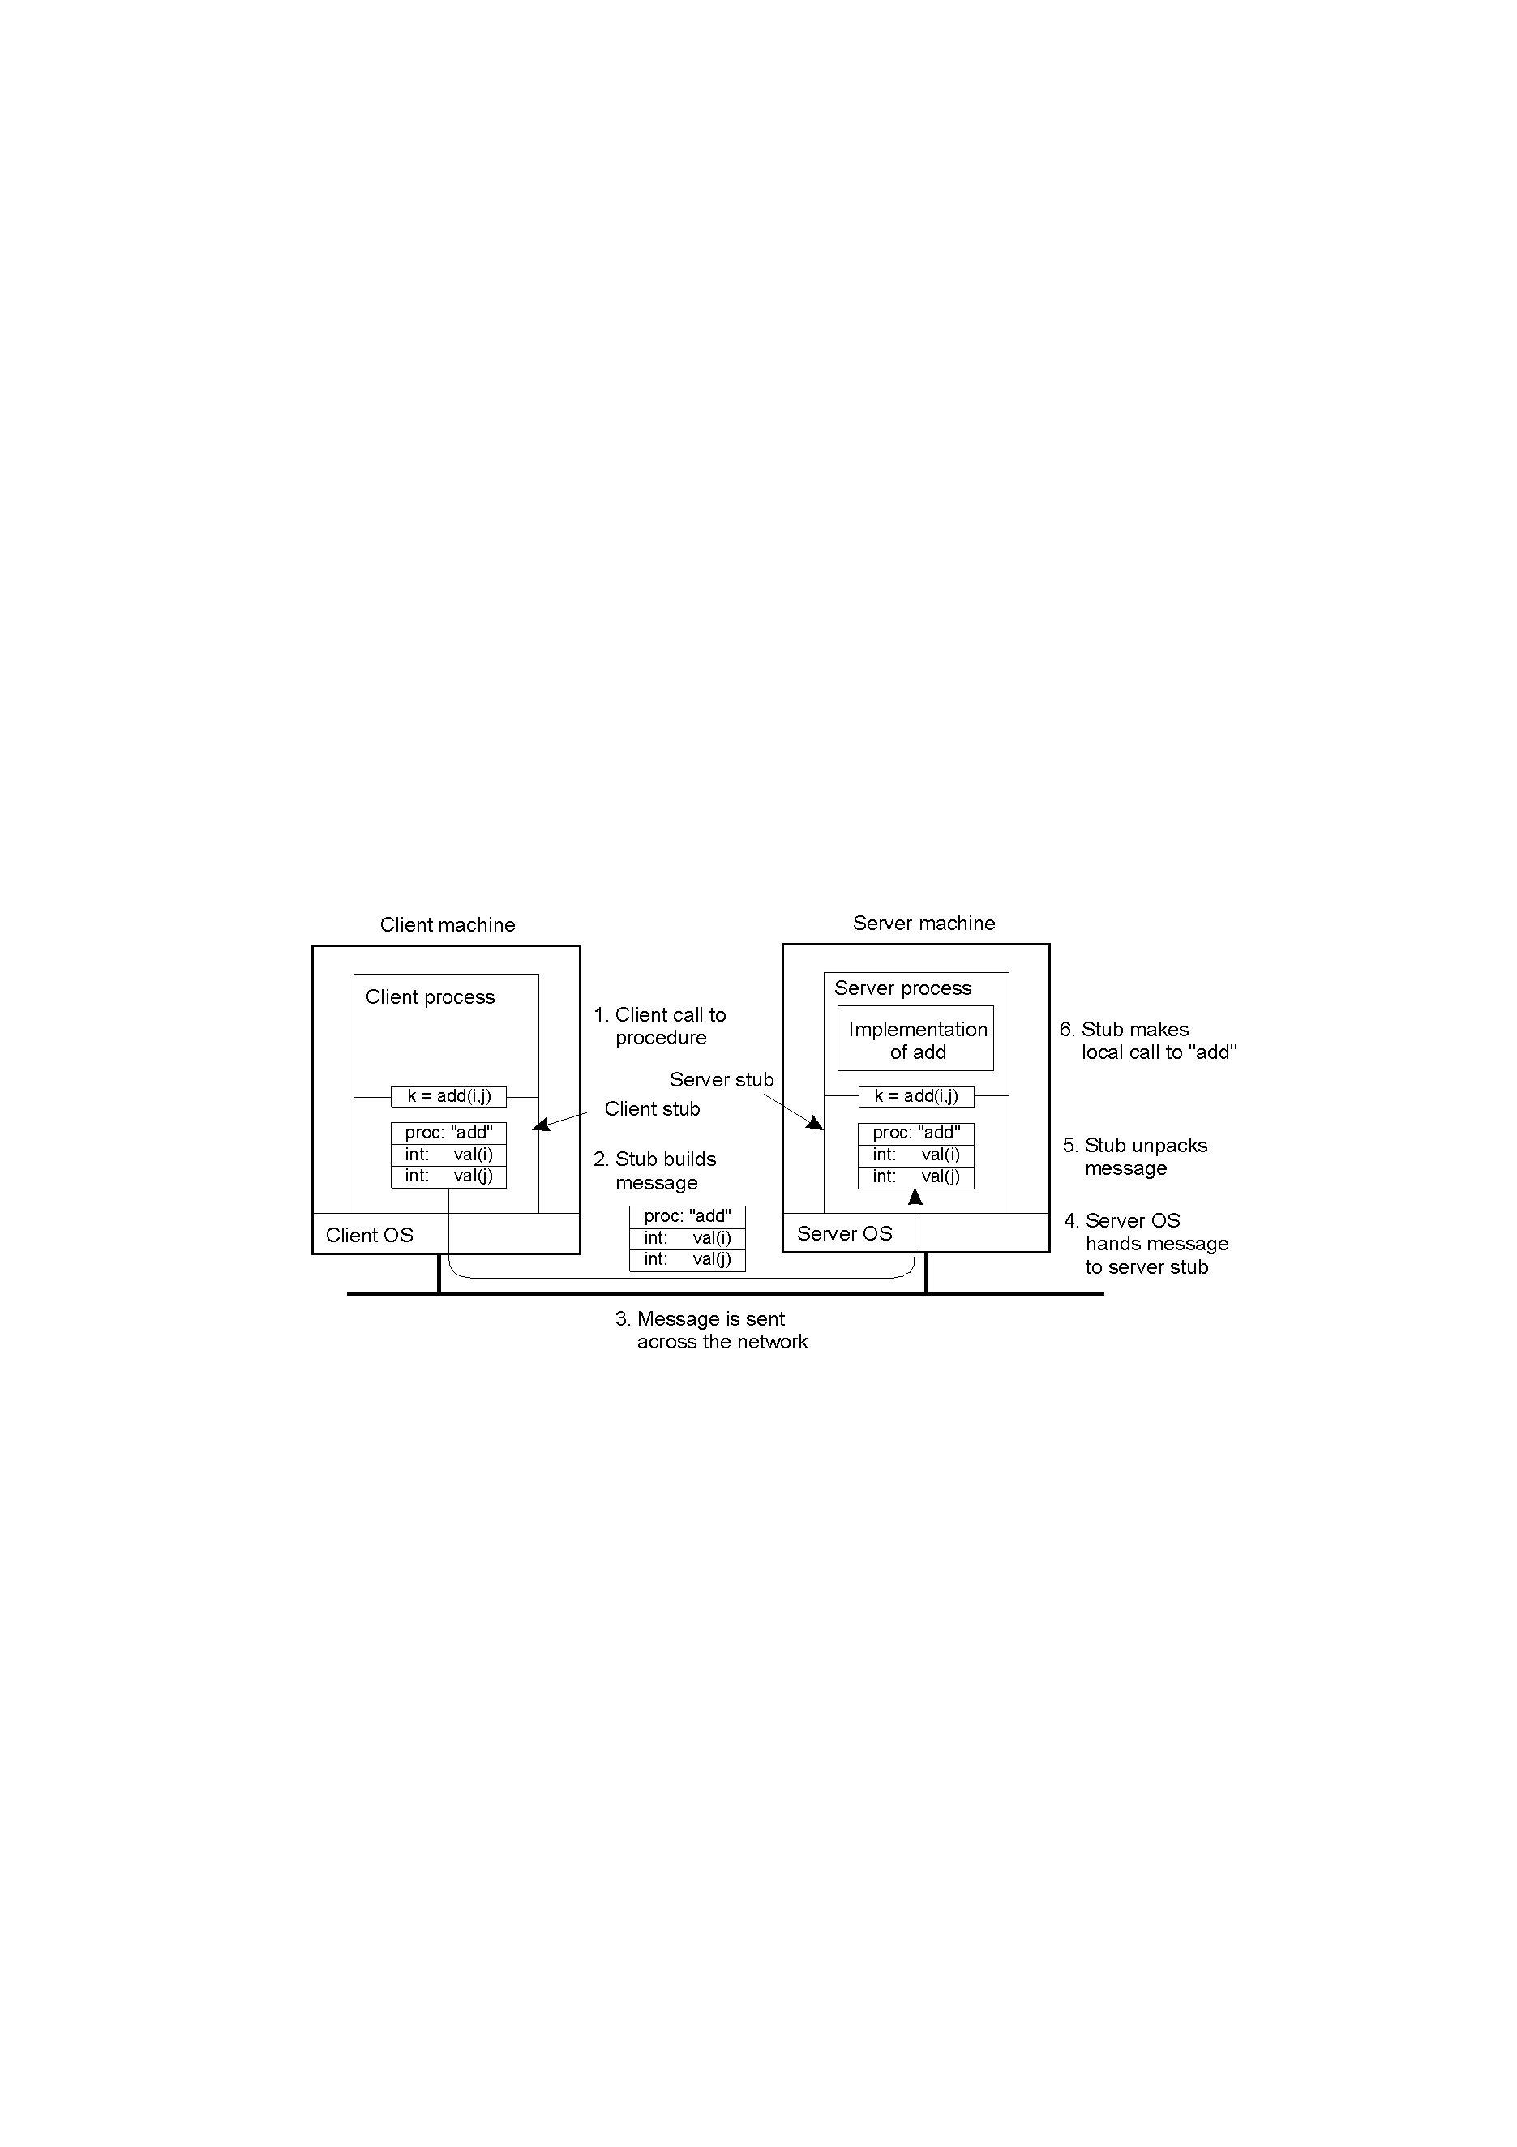
Passing Value Parameters (1)
Steps involved in doing remote computation through RPC

Slide 17

Passing Value Parameters (2)
In a large distributed system, multiple machine types are present
Each machine has its own representation for number, characters, and others data items.
Original message on the Pentium (little-endian)
The message after receipt on the SPARC (big-endian )
The message after being inverted. The little numbers in boxes indicate the address of each byte

Slide 18

Parameter Specification
Caller and callee agree on the format of message they exchange
Ex: word = 4 bytes
float = 1 word
character is the rightmost byte of word
=> the client stub must use this format and the server stub know that incoming message for foobar has this format

Slide 19
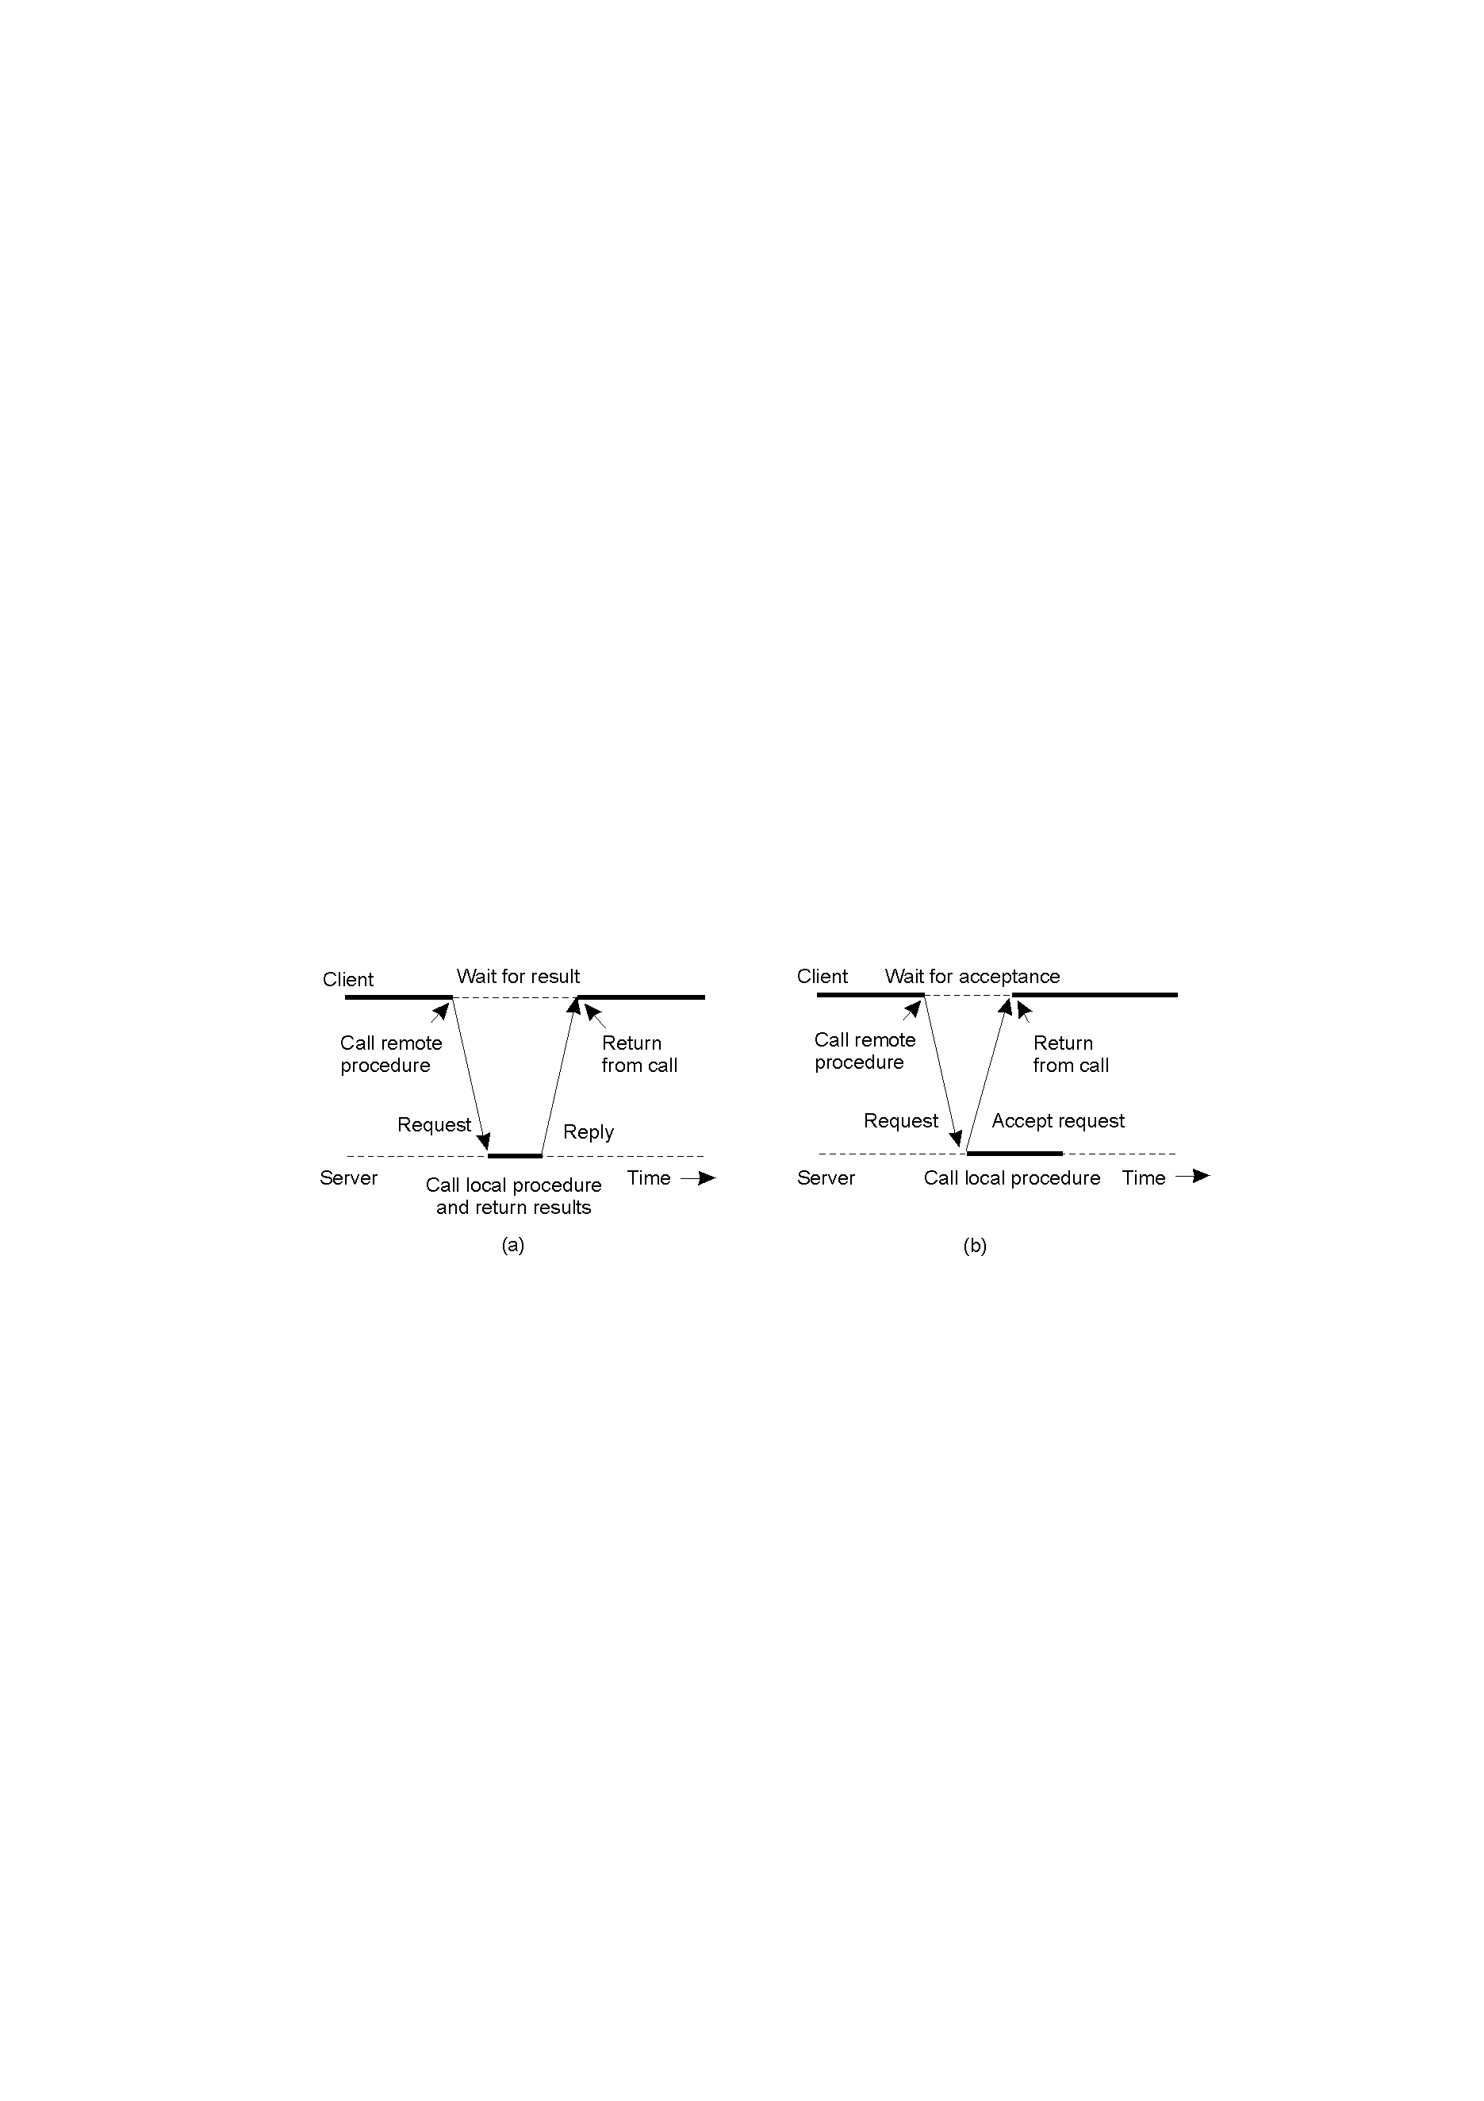
Asynchronous RPC (1)
Avoids blocking of the client process.
Allows the client to proceed without getting the final result of the call.
The interconnection between client and server in a traditional RPC
The interaction using asynchronous RPC

Slide 20
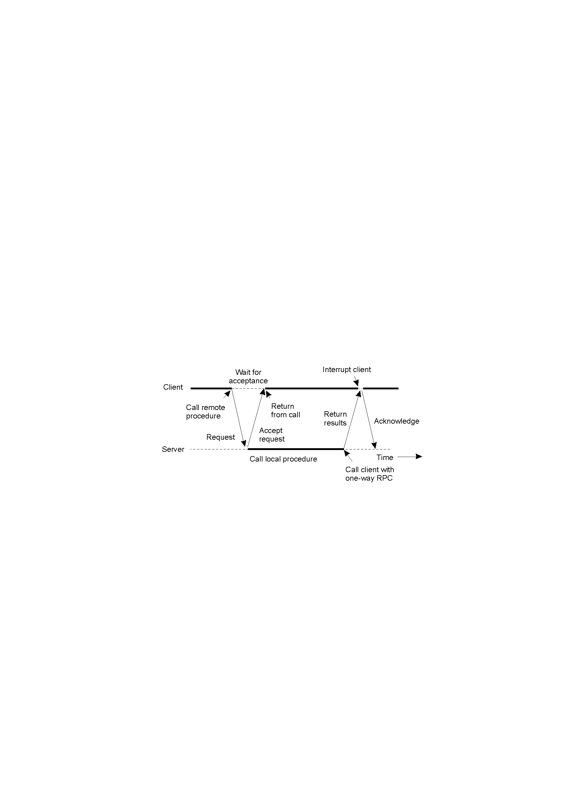
Differed synchronous
One-way RPC model: client does not wait for an acknowledgement of the server’s acceptance of the request.
A client and server interacting through two asynchronous RPCs

Slide 21
Example DCE RPC
What is DCE ? (Distributed Computing Environment)
  DCE is a true middleware system in that it is designed to execute as a layer of abstraction between exiting (network) operating system and distributed application.
-Goals of DCE RPC
  Makes it possible for client to access a remote service by simply calling a local procedure.
Components:
  Languages
  Libraries
  Daemon
  Utility programs
  Others

Slide 22
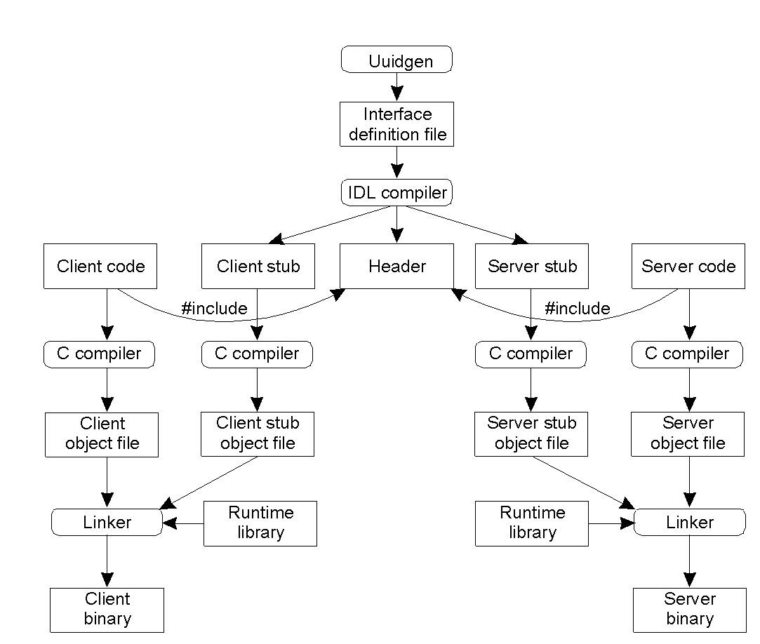
Writing a Client and a Server
Generate a prototype IDL file containing an interface identify
Filling in the names of remote procedure and their parameters
IDL compiler is call to compile into three files
2-14
The steps in writing a client and a server in DCE RPC.

Slide 23
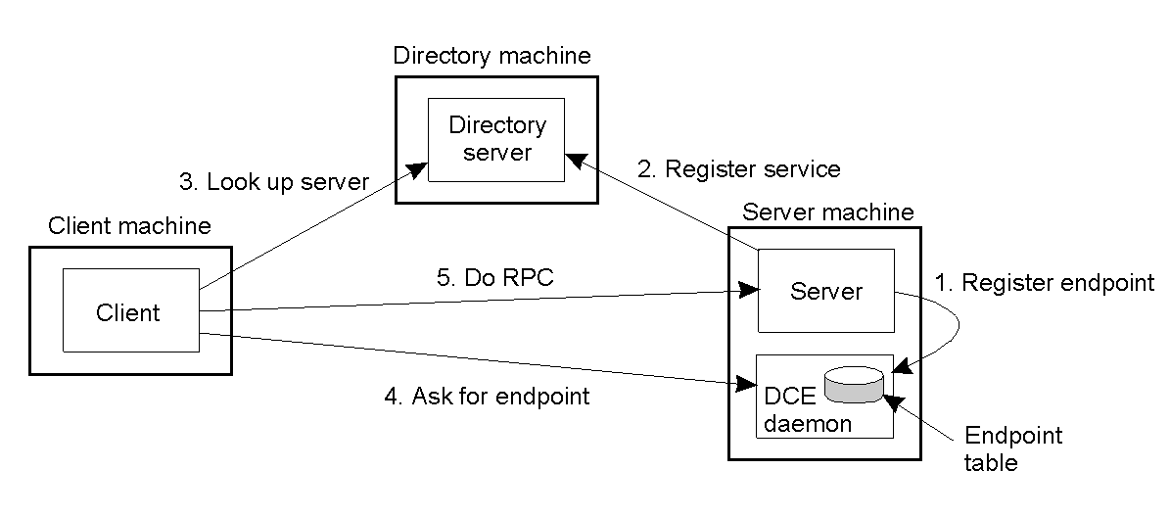
Binding a Client to a Server
Endpoint (port) is used by server’s OS to distinguish incoming message
Client-to-server binding in DCE.

Slide 24
3.3 Remote Object Invocation
Notes:
HI Everybody,
Before presenting I have something to say. This is the first time I present by English.
Therefore, I cant avoid mistake. I will try my best to express my understanding about this section clearly.
Now, I start, please.
As Mr. Shu Lei have just presented about Layered Protocol & Remote Procedure Call.
Next, I would like to introduce about Remote Object Invocation.

Slide 25
Objectives
RMI vs RPC
Remote Distributed Objects
Binding a client to object
Parameter Passing
Java RMI
Example
Summary
Notes:
This is outline about my presentation.
First, I show the primary difference btw RMI and RPC
And then What RMI is about
How to blind a client to object and Parameter Passing
Next, I say few feature of Java RMI and present a simple example
Finally, There is any summary.

Slide 26
RMI vs RPC
The primary difference between RMI and RPC:
  RPC is used for procedure – based application.
  RMI is used for distributed object systems.
  RMI is object oriented.
  RPC is procedural.
Notes:
So, What is the primary difference bwt RMI and RPC?
---------------
--------------
--------------
--------------

Slide 27
Remote Distributed Objects(1)
Objects separate their actual implementation from their interface
Distributed object = an object which publishes its interface on other machines
Remote object = a distributed object whose state is encapsulated (their state is not distributed)

Slide 28
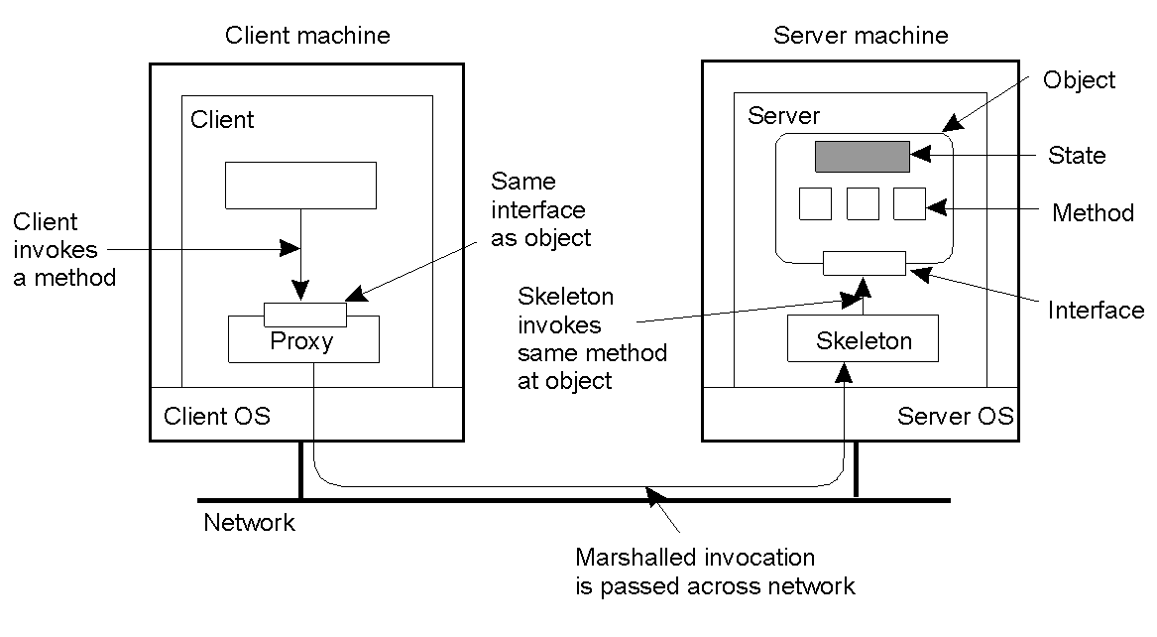
Remote Distributed Objects(2)
2-16
Common organization of a remote object with client-side proxy.
Notes:
This figure shows common organization of a remote object with client-side proxy.
The key feature of an object is that it encapsulates data, called the STATE
The operation on those data, called the METHOD.
Methods are made available through an interface
-When the client binds to a distributed object
-An implementation of the object’s interface, called a PROXY, is load into the client’s address space. Proxy marshal method invocations into message.
-and then Marshalled invocation is passed across network.
Incoming invocation requests are first passed to a SKELETON, which unmarshals them to proper method invocations at the object’ interface at the server
The Skeleton is also responsible for marshaling reply and forwarding message to client side proxy.

Slide 29
Binding a Client to an Object (1)
Two ways of binding:
  - Implicit: Invoke methods directly on the referenced object
  - Explicit: Client must first explicitly bind to object before invoking it
Notes:
When a process holds an object reference, it must first bind to the referenced object before invoking any of its methods.
There are 2 ways of binding -------------,------------------

Slide 30
Binding a Client to an Object (2)
Distr_object* obj_ref; //Declare a systemwide object reference
obj_ref = …; // Initialize the reference to a distributed object
obj_ref-> do_something(); // Implicitly bind and invoke a method
(a)
Distr_object objPref; //Declare a systemwide object reference
Local_object* obj_ptr; //Declare a pointer to local objects
obj_ref = …; //Initialize the reference to a distributed object
obj_ptr = bind(obj_ref); //Explicitly bind and obtain a pointer to the local proxy
obj_ptr -> do_something(); //Invoke a method on the local proxy
(b)
An example with implicit binding using only global references
An example with explicit binding using global and local references
Notes:
This is a example. First one, Implicitly bind and invoke a method.
Second, Explicitly bind and obtain a pointer to the local proxy.

Slide 31
Parameter Passing (1)
Pass remote object by reference
Pass local object by value
Local object = an object in the client’s address space
Notes:
So, when invoking a method with an object reference as parameter.
When the reference refer to a remote object then The object is passed by reference
When the reference refer to a local object then The object is passed by value

Slide 32
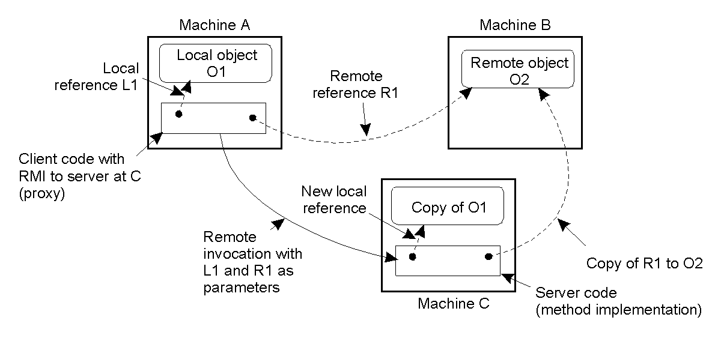
Parameter Passing (2)
The situation when passing an object by reference or by value.
2-18
program running on machine A, server program on machine B.
The client has a reference to a local on object O1 that it uses as a parameter when calling the server program on machine C.
And Client holds a reference to a remote object O2 residing at machine B which is also used as a parameter.
When calling the server, a copy of O1 is passed to the server on machine C, along with only a copy of the reference to O2.
This figure show the situation when passing an object by reference or value.
Notes:
program running on machine A, server program on machine B.
The client has a reference to a local on object O1 that it uses as a parameter when calling the server program on machine C.
And Client holds a reference to a remote object O2 residing at machine B which is also used as a parameter.
When calling the server, a copy of O1 is passed to the server on machine C, along with only a copy of the reference to O2.
This figure show the situation when passing an object by reference or value.
A client

Slide 33
Java RMI (1)
Distributed objects integrated into the Language
Goal is to achieve transparency!
Any serializable object type can be a parameter to an RMI
Local objects are passed by value, remote objects are passed by reference
Proxy can be used as a reference to a remote object: Possible to serialize the proxy and send it to another server

Slide 34
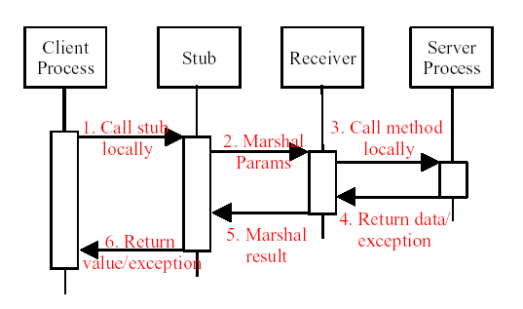
Java RMI (2)

Slide 35
Example
Integral Calculation with the following function:
  + Sin(x) (0 ÷ Pi)
  + Cos(x) (Pi/2 ÷ Pi)
  + X^2(0 ÷ 5)
  Approximate with 10, 100, 1000 steps.
The integral is calculated according to the midpoint rule.
Notes:
H = (a-b)/m m is step
Ck = a + (k-1/2)*h k =1,2,3…..m
Integral F(x) = h*Sum(F(Ck)) k=1,2….m

Slide 36
Example
Client
Server
RemoteIntegralClient
RemoteIntegralImpl
2
4
1
3
RemoteIntegral
rmiregistry
6
RemoteIntegralImpl_Stub
RemoteIntegralImpl_Skel
5
Notes:
This is a simple example.

Slide 37
Summary
RMI specific for a remote object
Remote object offer better transparence
RMIs allow object references to be passes as parameter
Local objects are passed by value
Remote objects are passed by reference

Slide 38
3.4 Message-Oriented Communication
Manhyung Han(smiley@oslab.khu.ac.kr)

Slide 39
Introduction
Message-Oriented Communication
  RPC and RMI enhanced access transparency
  But client have to blocked until its request has been processed
  Message-Oriented Communication can solve this problem by ‘messaging’
  Index:
    Meaning of synchronous behavior and its implication
    Various messaging systems
    Message-queuing system

Slide 40
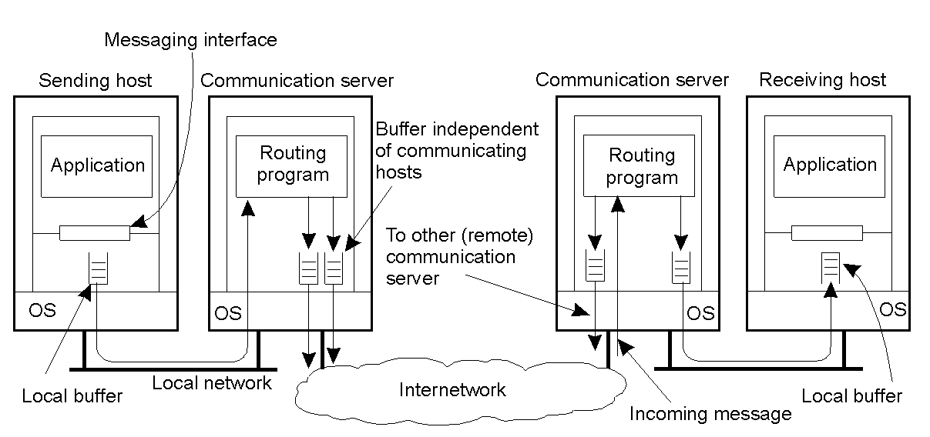
Persistence and Synchronicity in Communication(1)
General communication system connected through a network
  Each host is connected to a single communication server.
  Hosts and communication servers can have buffers.

Slide 41
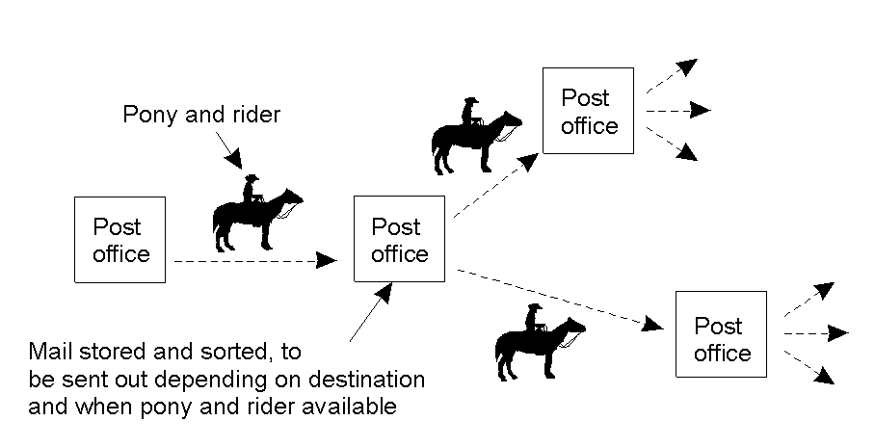
Persistence and Synchronicity in Communication(2)
Persistent communication
  An example of persistent communication – Letter back in the days of Pony Express

Slide 42
Persistence and Synchronicity in Communication(3)
Persistent vs. Transient
  Persistent messages are stored as long as necessary by the communication system (e.g., e-mail)
  Transient messages are discarded when they cannot be delivered (e.g., TCP/IP)
Synchronous vs. Asynchronous
  Asynchronous implies sender proceeds as soon as it sends the message no blocking
  Synchronous implies sender blocks till the receiving host buffers the message

Slide 43
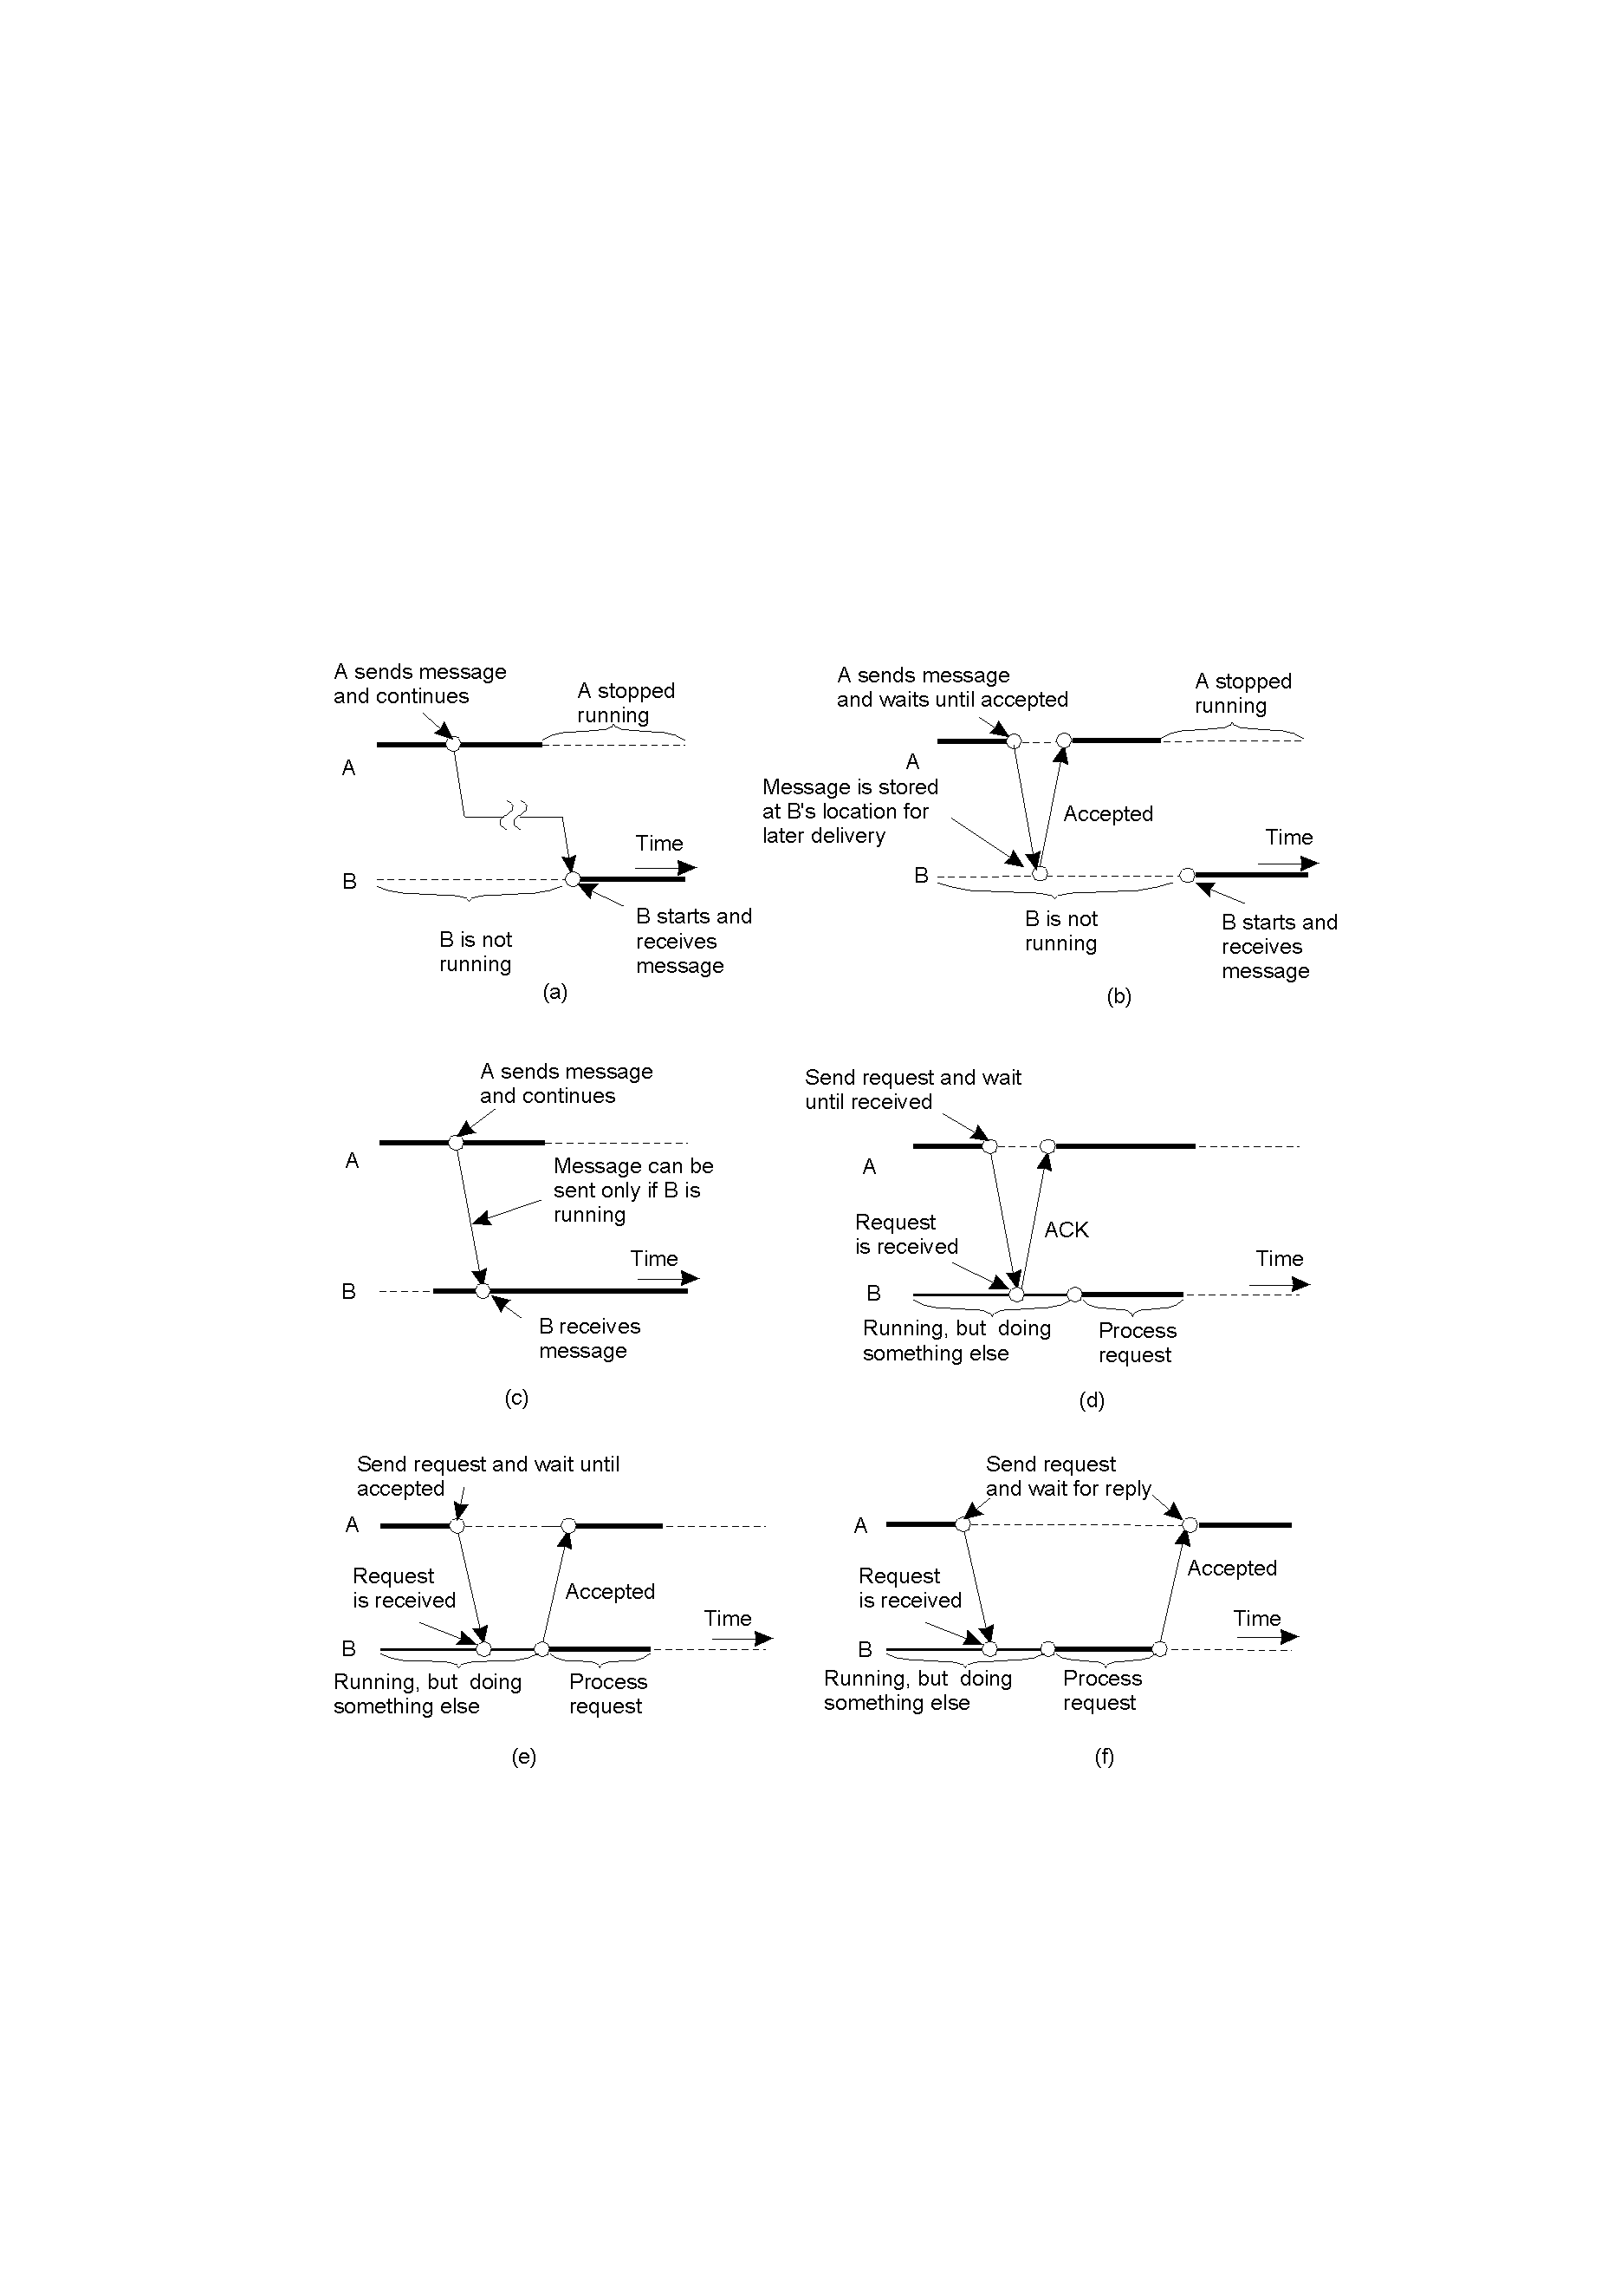
Persistence and Synchronicity in Communication(4)
Persistent asynchronous/synchronous communication
(a) Persistent asynchronous communication / (b) Persistent synchronous communication

Slide 44
Persistence and Synchronicity in Communication(5)
Transient asynchronous/Receipt-based transient synchronous communication
(c) Transient asynchronous communication / (d) receipt-based transient synchronous communication

Slide 45
Persistence and Synchronicity in Communication(6)
Other transient synchronous communications
(e) Delivery-based transient synchronous communication at message delivery
(f) Response-based transient synchronous communication

Slide 46
Message-Orient Transient Communication(1)
Message-Oriented Model
  Many distributed systems and applications are built on top of the simple message-oriented model
  These models are offered by Transport Layer
  Message-oriented models
    Berkeley Sockets: Socket interface as introduced in Berkeley UNIX
    The Message-Passing Interface(MPI): designed for parallel applications and as such in tailored to transient communication

Slide 47
Message-Orient Transient Communication(2)
Berkeley Sockets(1)
  Meaning of Socket: a communication endpoint to which an application can write data (be sent to network) and read incoming data
  The socket primitives for TCP/IP
Primitive | Meaning
Socket | Create a new communication endpoint
Bind | Attach a local address to a socket
Listen | Announce willingness to accept connections
Accept | Block caller until a connection request arrives
Connect | Actively attempt to establish a connection
Send | Send some data over the connection
Receive | Receive some data over the connection
Close | Release the connection

Slide 48
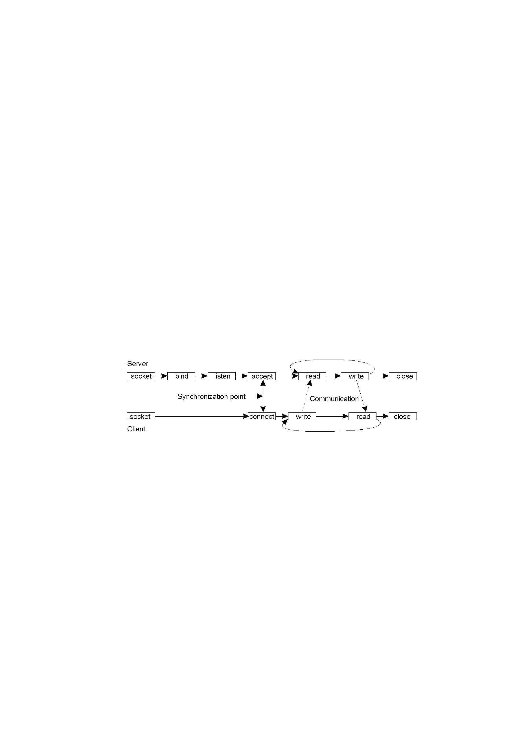
Message-Orient Transient Communication(3)
Berkeley Sockets(2)
  Connection-oriented communication pattern using sockets
  Sockets considered insufficient because:
    Support only send and receive primitives
    Designed for communication using general-purpose protocol such as TCP/IP
Create a new
endpoint
Associate
endpoint
Waiting
connection
Block waiting for reqs

Slide 49
Message-Orient Transient Communication(4)
The Message-Passing Interface(MPI)(1)
  Designed for multiprocessor machines and high-performance parallel programming
  Provides a high-level of abstraction than sockets
  Support diverse forms of buffering and synchronization (over 100 functions)

Slide 50
Message-Orient Transient Communication(5)
The Message-Passing Interface(MPI)(2)
  Some of the most intuitive message-passing primitives of MPI
Primitive | Meaning
MPI_bsend | Append outgoing message to a local send buffer
MPI_send | Send a message and wait until copied to local or remote buffer
MPI_ssend | Send a message and wait until receipt starts
MPI_sendrecv | Send a message and wait for reply
MPI_isend | Pass reference to outgoing message, and continue
MPI_issend | Pass reference to outgoing message, and wait until receipt starts
MPI_recv | Receive a message; block if there are none
MPI_irecv | Check if there is an incoming message, but do not block

Slide 51
Message-Orient Persistent Communication(1)
Message-Queuing Model(1)
  Apps communicate by inserting messages in specific queues
    Loosely-couple communication
  Support for:
    Persistent asynchronous communication
    Longer message transfers(e.g., e-mail systems)
  Basic interface to a queue in a message-queuing system:
Primitive | Meaning
Put | Append a message to a specified queue
Get | Block until the specified queue is nonempty, and remove the first message
Poll | Check a specified queue for messages, and remove the first. Never block
Notify | Install a handler to be called when a message is put into the specified queue

Slide 52
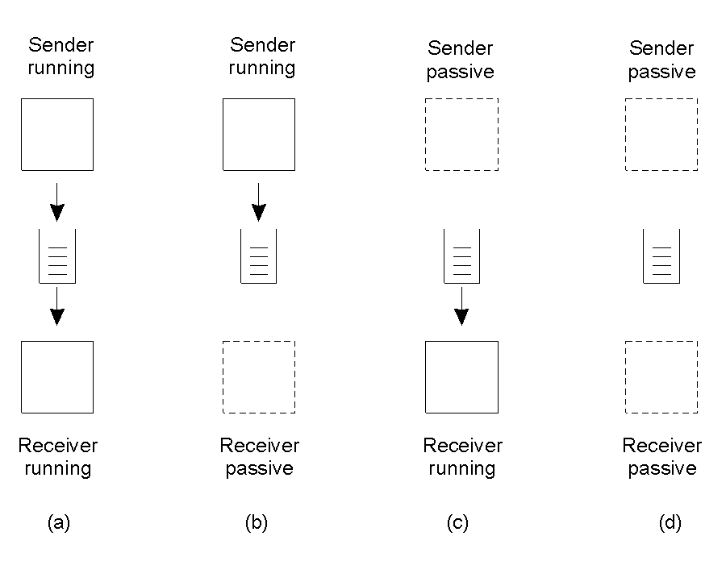
Message-Orient Persistent Communication(2)
Message-Queuing Model(2)
‘
  Four combinations for loosely-coupled communication using queues:

Slide 53
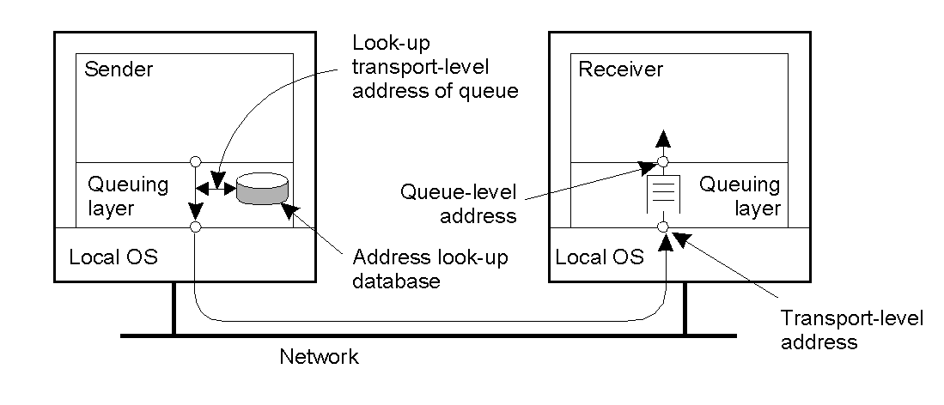
Message-Orient Persistent Communication(3)
General architecture of a Message-Queuing System(1)
  Messages can only be put and received from local queues
  Ensure transmitting the messages between the source queues and destination queues, meanwhile storing the messages as long as necessary
  Each queue is maintained by a queue manager
The relationship between queue-level addressing and network-level addressing

Slide 54
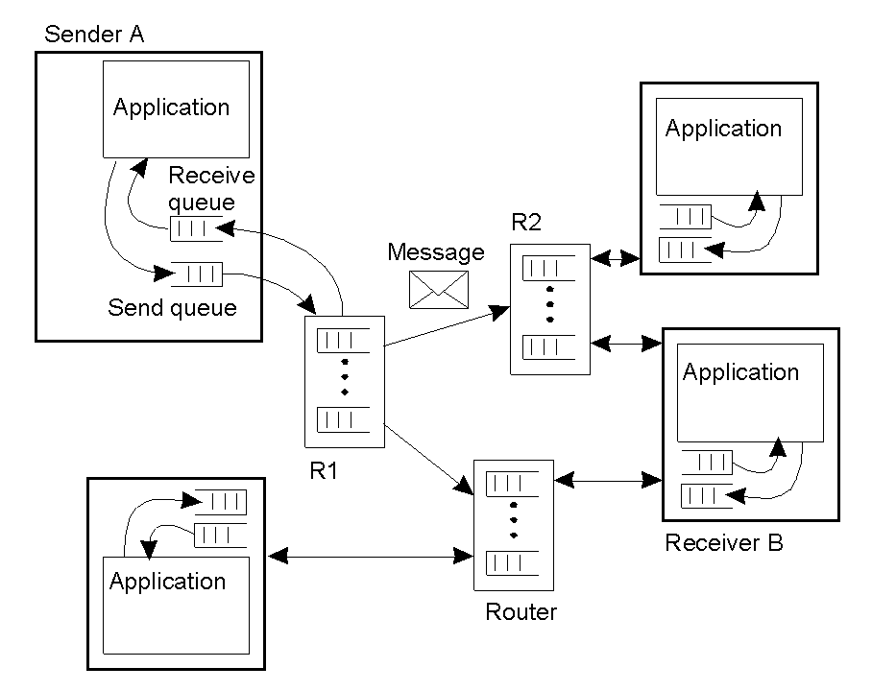
Message-Orient Persistent Communication(4)
General architecture of a Message-Queuing System(2)
  Queue managers are not only responsible for directly interacting with applications but are also responsible for acting as relays (or routers)
Queue managers form an overlay network, acting as routers

Slide 55
Message-Orient Persistent Communication(5)
General–purpose of a Message-Queuing System
  Enable persistent communication between processes
  Handling access to database
  In wide range of application, include:
    Email
    Groupware
    Batch processing

Slide 56
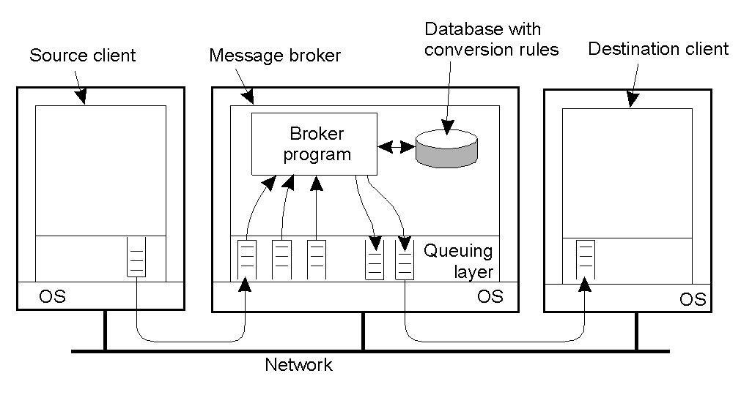
Message-Orient Persistent Communication(6)
Message Broker
The general organization of a message broker in a message-queuing system

Slide 57
Summary & Conclusion
Summary
  Two different communication concept ‘Transient vs. Persistent’
    Persistent messages are stored as long as necessary
    Transient messages are discarded when they cannot be delivered
  Message-Oriented Transient Comm.
    Berkeley socket and MPI
  Message-Oriented Persistent Comm.
    Message-Queuing Model and Message Broker
Conclusion
  Message-Oriented communication solve the blocking problems that may occur in general communication between Server/Client
  Message-Queuing systems can users(including applications) to do Persistent communication

Slide 58
2.5 Stream-Oriented Communication
Manhyung Han(smiley@oslab.khu.ac.kr)

Slide 59
Support for Continuous Media(1)
Types of media
  Continuous media
    Temporal dependence between data items
    ex) Motion - series of images
  Discrete media
    No temporal dependence between data items
    ex) text, still images, object code or executable files

Slide 60
Support for Continuous Media(2)
Data Stream
  Sequence of data units
  Discrete data stream: UNIX pipes or TCP/IP connection
  Continuous data stream: audio file (connection between file and audio devices)
Transmission modes
  Asynchronous: no timing constraints
  Synchronous: upper bound on propagation delay
  Isochronous: upper and lower bounds on propagation delay (transfer on time)

Slide 61
Support for Continuous Media(3)
Types of stream
  Simple stream
    consist of only a single sequence of data
  Complex stream
    consist of several related simple stream
    ex) stereo audio, movie
  Substream
    related simple stream
    ex) stereo audio channel

Slide 62
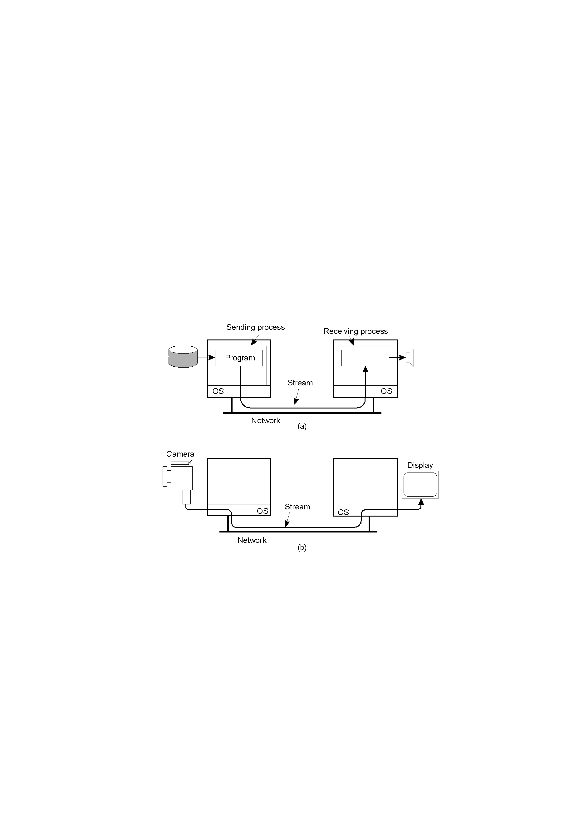
Support for Continuous Media(4)
Figure. 2-35
Setting up a stream between two processes across a network
Setting up a stream directly between two devices

Slide 63
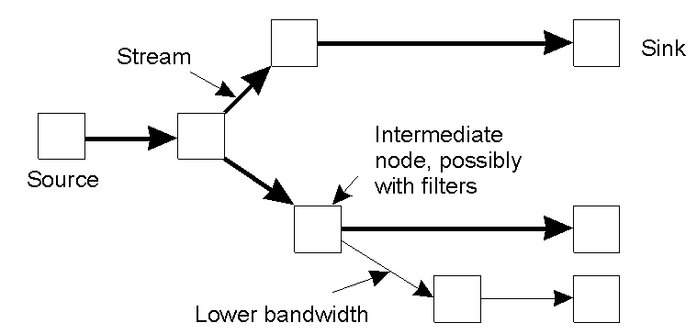
Support for Continuous Media(5)
Figure. 2-36
An example of multicasting a stream to several receivers

Slide 64
Streams and Quality of Service(1)
Specifying QoS(1)
  Flow specification
  To provide a precise factors(bandwith, transmission rates and delay, etc.)
  Example of flow specification developed by Partridge
Figure. 2-37 A flow specification
Characteristics of the Input | Service Required
Maximum data unit size (bytes) Token bucket rate (bytes/sec) Token bucket size (bytes) Maximum transmission rate (bytes/sec) | Loss sensitivity (bytes) Loss interval (microsec) Burst loss sensitivity (data units) Minimum delay noticed (microsec) Maximum delay variation (microsec) Quality of guarantee

Slide 65
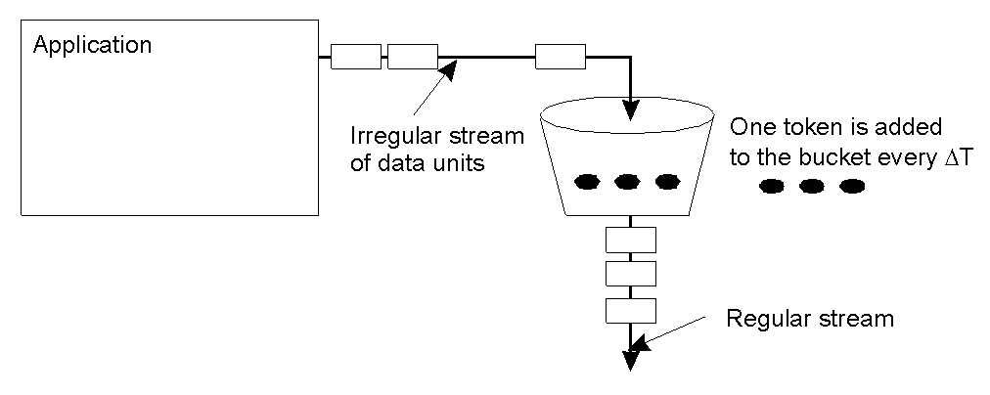
Streams and Quality of Service(2)
Specifying QoS(2)
  Token bucket algorithms
    Tokens are generated at a constant rate
    Token is fixed number of bytes that an application is allowed to pass to the network
Figure. 2-38
The Principle of a token bucket algorithm

Slide 66
Streams and Quality of Service(3)
Setting up a stream
  Resource reSerVation Protocol(RSVP)
    Transport-level control protocol for enabling resource reservation in network router
    Used to provide QoS for continuous data streams by reserving resources (bandwidth, delay, jitter and so on)
    Issue: How to translate QoS parameters to resource usage?
      Two ways to translate
      1. RSVP translates QoS parameters into data link layer parameters
      2. Data link layer provides its own set of parameters (as in ATM)

Slide 67
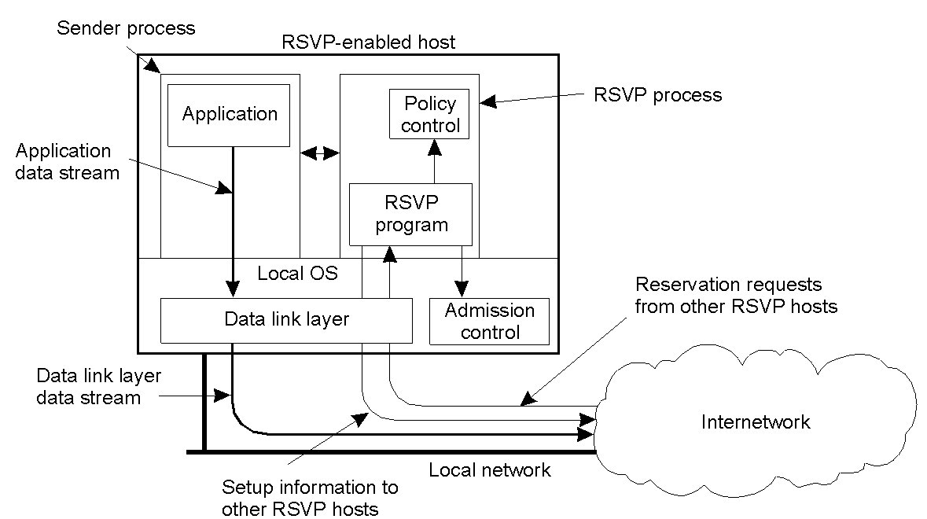
Streams and Quality of Service(4)
Figure. 2-39
The basic organization of RSVP for resource reservation in a distributed system

Slide 68
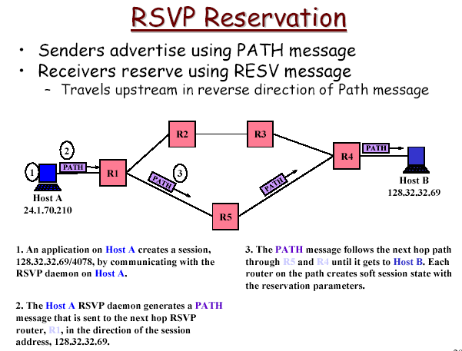
Streams and Quality of Service(5)

Slide 69
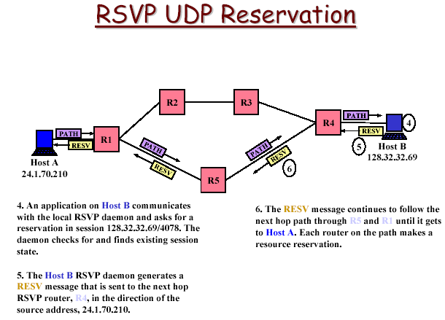
Streams and Quality of Service(6)

Slide 70
Stream Synchronization(1)
Basic ideas
  Synchronize transmission of data units
  Synchronization take place when the data stream is made up
    Stereo audio with CD quality(16 bit samples)
      Sampling rate 44.1 KHz -> synchronize 22.6 micro sec
  Synchronization between audio stream and video stream for lip sync.
    NTSC 30Hz(a frame every 33.33ms), CD Quality sound
      Synchronized every 1470 sound samples

Slide 71
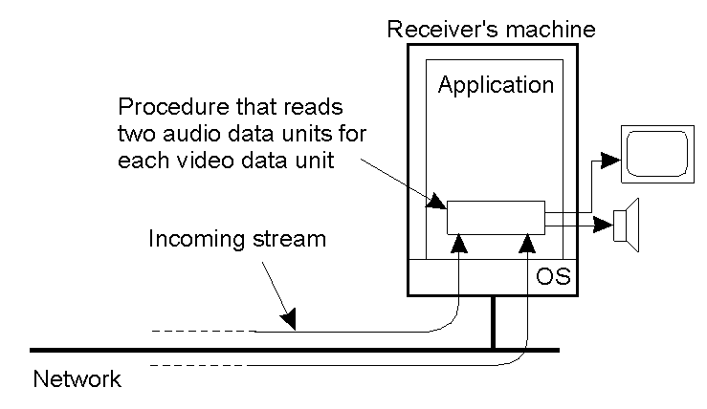
Stream Synchronization(2)
Synchronization Mechanisms(1)
Figure. 2-40
The principle of explicit synchronization on the level data units

Slide 72
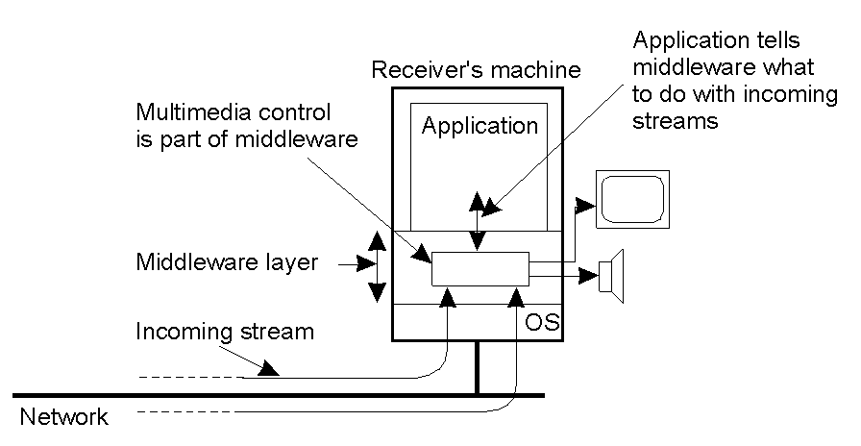
Stream Synchronization(3)
Synchronization Mechanisms(2)
Figure. 2-41
The principle of synchronization as supported by high-level interfaces

